Slide 1
Reinforcement learning

Slide 2
Reinforcement learning
Overview of RL:
RL vs other forms of learning
RL “API”
Applications
Framework: Markov Decision Processes (MDP’s)
Definitions and notations
Policies and Value Functions
Solving MDP’s
Value Iteration
Policy Iteration

Slide 3
Types of learning
Supervised learning y = f(x)

Slide 4

Supervised
Data: (x,y)
x - images, y - labels
Goal: learn function to map x->y
Examples: classification, regression, object detection, speech recognition, semantic segmentation, etc
Dog

Slide 5
Types of learning
Supervised learning y = f(x)
Unsupervised learning f(x)

Slide 6
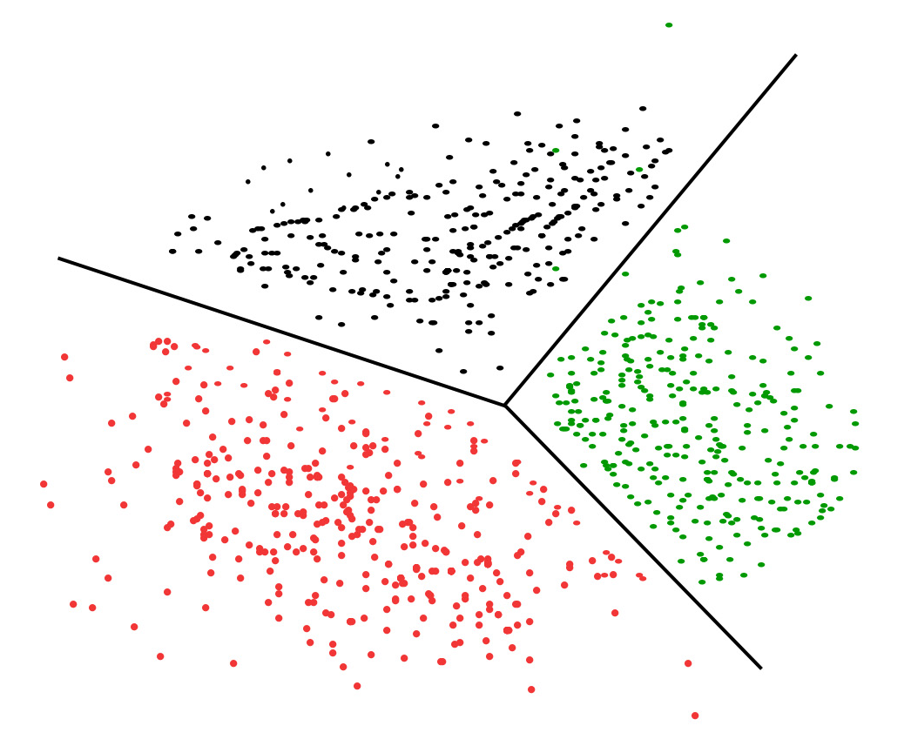
Unsupervised
Data: (x)
No labels, only x
Goal: Learn some underlying
hidden structure of the data
Examples: Clustering, dimensionality reduction, feature learning, density estimation, etc.

Slide 7
Types of learning
Supervised learning y = f(x)
Unsupervised learning f(x)
Reinforcement learning y = f(x)
z

Slide 8
Reinforcement learning
Data: x
x - some
Environment: z
z - world we are exploring
Goal: Learn how to operate(live) in a world z in most beneficial way
Examples: playing games(chess, Mario, go, Dota), self-driving(car, planes, helicopters), robot manipulations

Slide 9
Examples
Dota 2 https://openai.com/projects/five/

Slide 10
Examples
Dota 2 https://openai.com/projects/five/
AlphaGo

Slide 11
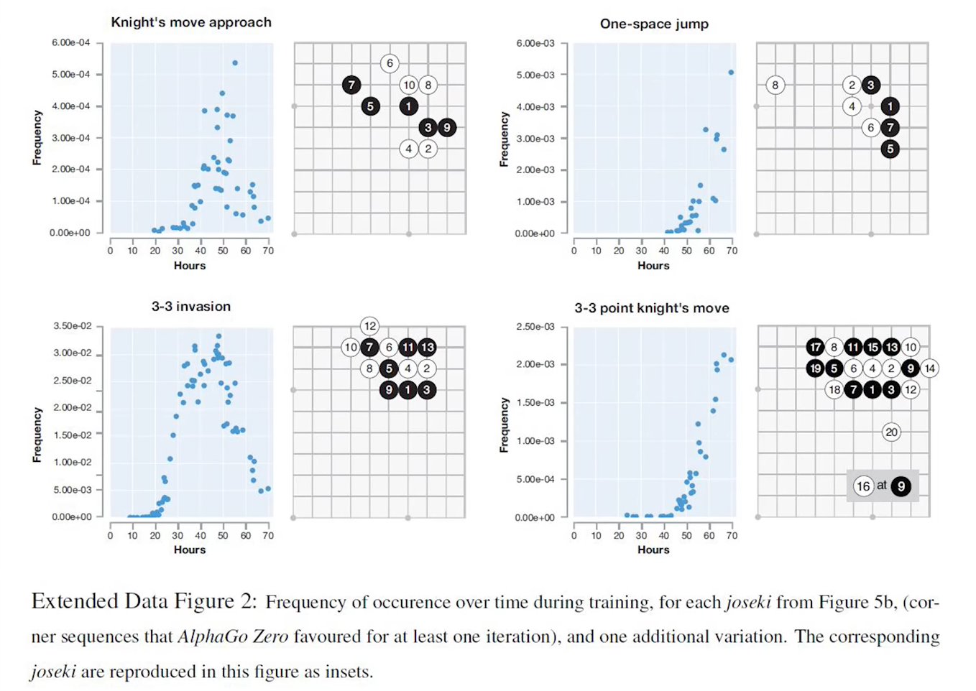

Slide 12
Examples
Dota 2 https://openai.com/projects/five/
AlphaGo
Hide&Seek

Slide 13


Slide 14
Examples
Dota 2 https://openai.com/projects/five/
AlphaGo
Hide&Seek
Learn how to walk

Slide 15


Slide 16
The world
What is the shortest sequence of actions to go from START to GOAL?
 |  |  | GOAL
START
UP, DOWN, RIGHT, LEFT

Slide 17
The world
What is the shortest sequence of actions to go from START to GOAL?
 |  |  | GOAL
UP, DOWN, RIGHT, LEFT

Slide 18
The world
What is the shortest sequence of actions to go from START to GOAL?
 |  |  | GOAL
UP, DOWN, RIGHT, LEFT

Slide 19
The world
What is the shortest sequence of actions to go from START to GOAL?
 |  |  | GOAL
UP, DOWN, RIGHT, LEFT
0.8 action executes correctly
0.2 we go orthogonally instead

Slide 20
The world
What’s the reliability of this sequence of actions?
 |  |  | GOAL
UP, DOWN, RIGHT, LEFT
0.8 action executes correctly
0.2 we go orthogonally instead

Slide 21
The world
What’s the reliability of this sequence of actions?
 |  |  | GOAL
UP, DOWN, RIGHT, LEFT
0.8 action executes correctly
0.2 we go orthogonally instead
0.8*0.8*0.8*0.8*0.8 = 0.32768

Slide 22
The world
What’s the reliability of this sequence of actions?
 |  |  | GOAL
UP, DOWN, RIGHT, LEFT
0.8 action executes correctly
0.2 we go orthogonally instead
0.8*0.8*0.8*0.8*0.8 = 0.32768

Slide 23
The world
What’s the reliability of this sequence of actions?
 |  |  | GOAL
UP, DOWN, RIGHT, LEFT
0.8 action executes correctly
0.2 we go orthogonally instead
0.8*0.8*0.8*0.8*0.8 + 0.1*0.1*0.1*0.1*0.8 = 0.32776

Slide 24
Markov Decision Process
States: S
Actions: A(s), A
Model: T(s, a, s′) ~ Pr(s′ | s, a)

Slide 25
Markov Decision Process
States: S Markovian property:
Actions: A(s), A - only current state matters
Model: T(s, a, s′) ~ Pr(s′ | s, a) - rules don’t change

Slide 26
Markov Decision Process
States: S
Actions: A(s), A
Model: T(s, a, s′) ~ Pr(s′ | s, a)
Reward: R(s), R(s, a), R(s, a, s′)
 |  |  | +1
 |  |  | -1
START

Slide 27
Markov Decision Process
States: S
Actions: A(s), A
Model: T(s, a, s′) ~ Pr(s′ | s, a)
Reward: R(s), R(s, a), R(s, a, s′)
_____________________________________
Policy: P(s) -> a
P*

Slide 28
Markov Decision Process
States: S
Actions: A(s), A
Model: T(s, a, s′) ~ Pr(s′ | s, a)
Reward: R(s), R(s, a), R(s, a, s′)
_____________________________________
Policy: P(s) -> a Supervised: x = s, y = a
P* Reinforcement: x = s, z = r, y = a, f(x) = P(s)

Slide 29
Reward function
Delayed reward
Minor changes to reward matter
R(s) = -0.04
→ | → | → | +1
↑ |  | ↑ | -1
↑ | ← | ← | ←

Slide 30
Reward function
Delayed reward
Minor changes to reward matter
R(s) = +2
R(s) = -2
 |  | ? | +1
 |  | ? | -1
 |  | ? | ?

Slide 31
Reward function
Delayed reward
Minor changes to reward matter
R(s) = +2
 |  | ← | +1
 |  | ← | -1
 |  | ↔ | ↓
↕

Slide 32
Reward function
Delayed reward
Minor changes to reward matter
R(s) = -2
 |  | → | +1
 |  | → | -1
 |  | → | ↑

Slide 33
Reward function
Delayed reward
Minor changes to reward matter
R(s) = -2
→ | → | → | +1
↑ |  | → | -1
→ | → | → | ↑

Slide 34
Reward function
R(s) = -0.04 R(s) = -2
→ | → | → | +1
↑ |  | ↑ | -1
↑ | ← | ← | ←
→ | → | → | +1
↑ |  | → | -1
→ | → | → | ↑

Slide 35
Assumptions
Infinite horizons
Utility of state sequences:
If (S0, S1, S2 … ) > (S0, S1′, S2′ … ) then
( S1, S2 … ) > ( S1′, S2′ … )

Slide 36
Assumptions
Infinite horizons
Utility of state sequences:
U(S0, S1, S2 … ) = ∑∞_{t=0} R(S_{t})
+1 +1 +1 +1 + 1 + 1 +1 +1 … ? +1 +1 +1 +2 + 1 + 1 +2 +1 ...

Slide 37
Assumptions
Infinite horizons
Utility of state sequences:
U(S0, S1, S2 … ) =
∑∞_{t=0} R(S_{t}) = ∑∞_{t=0} Ɣ^{t} R(S_{t}) = 0 < Ɣ < 1
= R_{max} / (1- Ɣ)

Slide 38
Policies
P* = argmax_{p} E [ ∑∞_{t=0} Ɣ^{t} R(S_{t}) | P]

Slide 39
Policies
P* = argmax_{p} E [ ∑∞_{t=0} Ɣ^{t} R(S_{t}) | P]
U^{p}(s) = E [ ∑∞_{t=0} Ɣ^{t} R(S_{t}) | P, s ₀ = s] ≠ R(s)

Slide 40
Policies
P* = argmax_{p} E [ ∑∞_{t=0} Ɣ^{t} R(S_{t}) | P]
U^{p}(s) = E [ ∑∞_{t=0} Ɣ^{t} R(S_{t}) | P, s ₀ = s] ≠ R(s)
P*(s) = argmax_{a} ∑_{s′} T(s, a, s′) U^{p*}(s′)

Slide 41
Policies
P* = argmax_{p} E [ ∑∞_{t=0} Ɣ^{t} R(S_{t}) | P]
U^{p}(s) = E [ ∑∞_{t=0} Ɣ^{t} R(S_{t}) | P, s ₀ = s] ≠ R(s)
P*(s) = argmax_{a} ∑_{s′} T(s, a, s′) U^{p*}(s′)
U(s) = R(s) + Ɣmax_{a} ∑_{s′} T(s, a, s′) U(s′) -> Bellman equation

Slide 42
Value iteration
U(s) = R(s) + Ɣmax_{a} ∑_{s′} T(s, a, s′) U(s′)
Start with random utility values
Update based on neighbors
Repeat until convergence

Slide 43
U(s) = R(s) + Ɣmax_{a} ∑_{s′} T(s, a, s′) U(s′)
U₁(s) = ?
U₂(s) = ?
Ɣ = 0.5 R(s) = -0.04 U₀(s) = 0
 |  | ? | +1
 |  |  | -1

Slide 44
U(s) = R(s) + Ɣmax_{a} ∑_{s′} T(s, a, s′) U(s′)
U₁(s)= -0.04 + 0.5*0.8 =
= 0.36
U₂(s)=
Ɣ = 0.5 R(s) = -0.04 U₀(s) = 0
 |  | 0.36 | +1
 |  | -0.04 | -1

Slide 45
U(s) = R(s) + Ɣmax_{a} ∑_{s′} T(s, a, s′) U(s′)
U₁(s)= -0.04 + 0.5*0.8 =
= 0.36
U₂(s)= -0.04+0.5(0.8 +
0.1*0.36+0.1*(-0.04))=0.376
Ɣ = 0.5 R(s) = -0.04 U₀(s) = 0
 |  | 0.36 | +1
 |  | -0.04 | -1

Slide 46
Finding Policies: Policy iteration
Start with random P₀
Evaluate: given P_{t} calculate U_{t} = U^{P}_{t}
Improve: P_{t+1} = argmax_{a} ∑_{s′} T(s, a, s′) U_{t}(s′)
U_{t}(s) = R(s) + Ɣ ∑_{s′} T(s, P_{t}(s), s′) U_{t}(s′)

Slide 47
Thank you

